Slide 1
Geographical NOMA-Beamforming in Multi-Beam Satellite-Based Internet of Things
2019 IEEE Global Communications Conference (GLOBECOM)
Yazhou Zhu, Thomas Delamotte, and Andreas Knopp
Bundeswehr University of Munich, Chair of Signal Processing, 85579 Neubiberg, Germany.
Notes:
這篇是基於地理性的NOMA Beamforming scheme，目的是為了提高頻譜效率，每個beam都有一個primary user， primary user透過 noma ，以較小的data rate服務，這樣同時也有機會為其他user提供服務，

Slide 2
Introduction
In the fifth generation (5G) of mobile communications, connecting billions of Internet of Things (IoT) devices is not a trivial task.
In a time division multiple access (TDMA) based satellite system with large delay and massive connections, a holdover time is mandatory, during which the system continues to assign a small amount of bandwidth exceeding the requested bandwidth in the anticipant traffic.
Notes:
在5G通訊中，連接數十億個 IoT設備不是件容易的事。但5G衛星可以為設備提供服務連續性和可用性，此外，beamforming是一種用於multi-beam satellite的full frequency reuse 的信號處理技術，可實現high throughput。在一班使用TDMA 方式的full frequency 的衛星繪有很嚴重的delay ，且會有一個holdover time ，在這hold over time裡衛星繪持續分配頻寬，因此實際上會有很多未使用的頻寬，導致TDMA的頻譜效率降低。

Slide 3
Introduction
Most of the existing NOMA schemes base on the assumption that the channel conditions of the users are significantly different.
Notes:
為了滿足上述要求，作者研究在基於multi-beam satellite中應用NOMA。
現有的大多數NOMA方案都基於以下假設：用戶的信道條件明顯不同。
因為要明顯不同，接收者才有辦法利用sic解出來

Slide 4
Introduction
This work is to propose a geographical NOMA-BF scheme, where a primary user per beam needs to be timely served with a small target data rate.
Then, a heuristic multi-layer BF architecture is proposed for reducing inter-beam interference, augmenting the difference of the users' effective channel gains and performing inter-beam power allocation in three steps.
Notes:
為了在基於multibeam satellite的iot中提供高頻譜效率，這項工作是提出一種geographical NOMA-BF scheme，該方案中需要及時為每個beam的primary user提供較小的target data rate。使用NOMA概念可以為每個beam提供其他用戶機會。具體而言，作者首先設計一種user scheduling 以提高頻譜效率。然後，提出了一種heuristic multi-layer beamforming 架構，以減少beam間干擾，擴大用戶有效信道增益的差異並執行beam之間的功率分配。

Slide 5

SYSTEM MODEL

Slide 6
A GEO provides massive connectivity by means of multiple beams, where the satellite is equipped with an array-fed reflector antenna with N feeds. a total of K = N beams are realized.
A primary user per beam is timely served with a small data rate (i.e. narrowband data) such as real-time safety-critical healthcare applications, while the remaining users are opportunistically served with the best effort
Notes:
這邊是使用GEO，然後共有N個beam， 每個beam之中都有一個primary user, 必須及時被服務以及有著基本要求的 small data rate( 譬如說 :一個探測身體狀況的生命儀器)，而其他users也有機會同時被服務。

Slide 7

In the satellite industry, a two-way VSAT is usually employed to provide narrowband data or satellite Internet access to individuals and companies.
A general VSAT antenna must have an unobstructed view of the sky to allow for proper line-of- sight (LOS) to the satellite, along with a beam association procedure for Ka-band multi-beam satellites.
Due to the strong LOS channel characteristic, the vector of channel coefficients between user i in beam b and the N feeds on the satellite is
Notes:
VSAT 是小型衛星地面站，通常可以為家用或公司來服務，但他有light of sight 的限制，由於有light of sight的限制，他的通道狀況就可以直接使用他的一些要考慮的參數，
H代表通道狀況的vector，

Slide 8
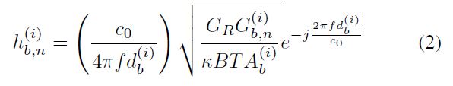

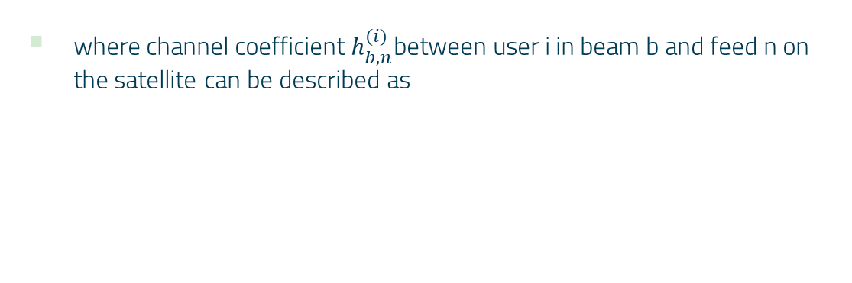
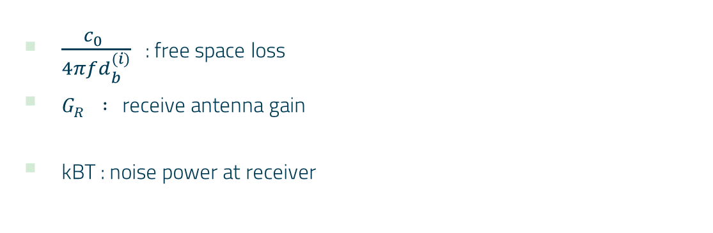
where channel coefficient $h_{b,n}^{(i)}$between user i in beam b and feed n on the satellite can be described as
$\frac{c_{0}^{}}{4πfd_{b}^{(i)}}$ : free space loss
$G_{R}^{} :$ receive antenna gain
kBT : noise power at receiver
Notes:
通道的狀況可以用下面的公式計算，
$d_{b}^{(i)}$ : satellite 與user I 的距離
$A_{b}^{(i)}$ : 雨衰

Slide 9
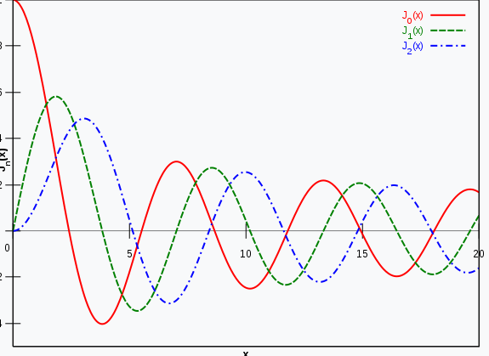
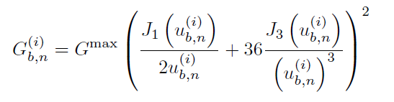
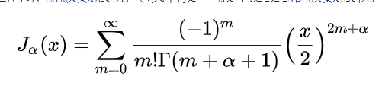
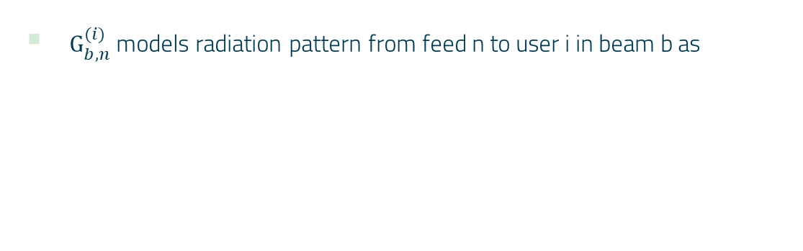
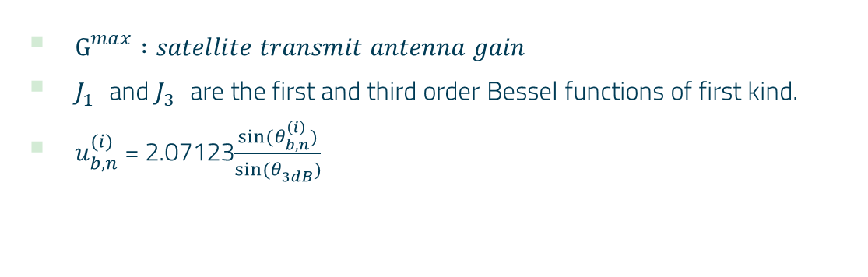
$G_{b,n}^{(i)}$ models radiation pattern from feed n to user i in beam b as
$G_{}^{max} :satellite transmit antenna gain$
$J_{1}^{}$ and $J_{3}^{}$ are the first and third order Bessel functions of first kind.
$u_{b,n}^{(i)}$ = 2.07123$\frac{sin⁡(θ_{b,n}^{\left(i\right)})}{sin⁡(θ_{3dB}^{})}$
Notes:
G 代表 user I 在beam b 的beam gain 可以用這樣表示 Bessel functions
user i in beam b 2的離軸角

Slide 10
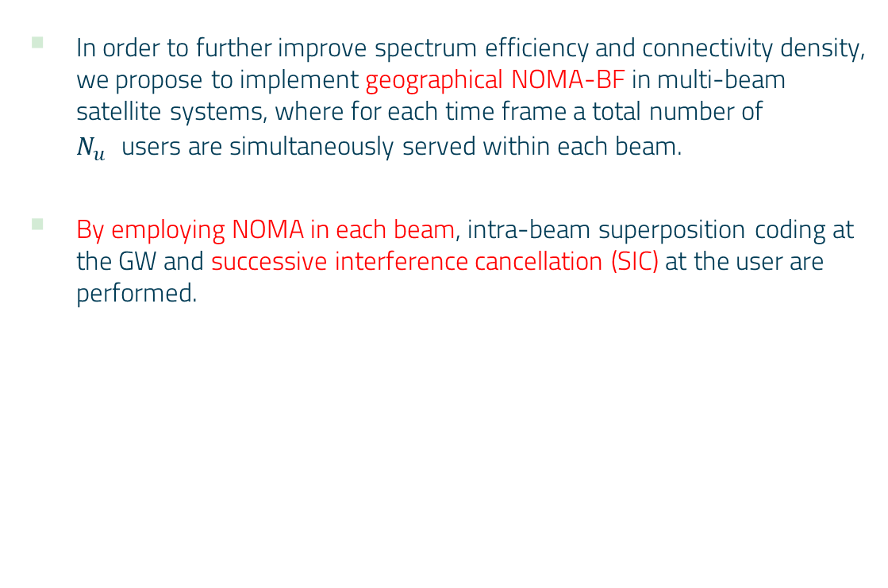
In order to further improve spectrum efficiency and connectivity density, we propose to implement geographical NOMA-BF in multi-beam satellite systems, where for each time frame a total number of $N_{u}^{}$users are simultaneously served within each beam.
By employing NOMA in each beam, intra-beam superposition coding at the GW and successive interference cancellation (SIC) at the user are performed.
Notes:
每個時間範圍內，在每個波束中同時為Nu用戶提供服務，是geographical noma –bf 的目標，每個beam透過noma，可以疊加訊號，並在接收端使用sic做訊號分離。

Slide 11
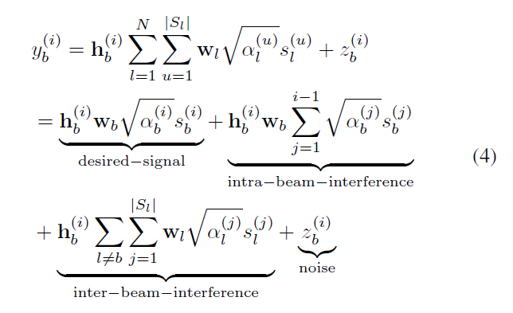
Correspondingly, the remaining received signal at user i in beam b is written as
Notes:
User I 收到的訊號可以用以下的式子表示 第一行代表他收到的所有訊號，等同於，把它拆解成2、3行， 有user想收的訊號，以及beam內ㄉ干擾，還有beam之間的干擾，及雜訊。

Slide 12
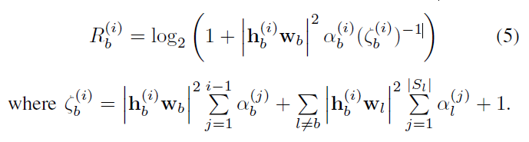
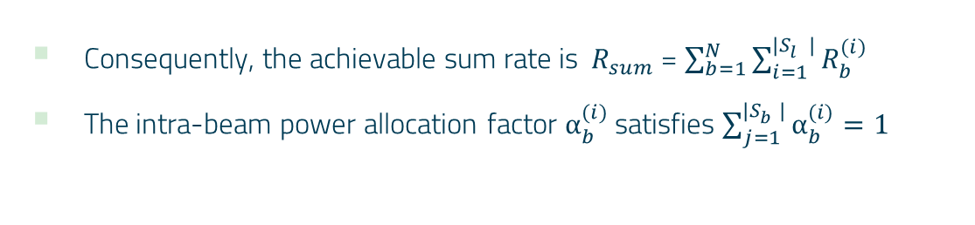
Then, the achievable rate for user i in beam b is expressed as
Consequently, the achievable sum rate is $R_{sum}^{}$ = $\sum_{b=1}^{N}{\sum_{i=1}^{{|S}_{l}^{}|}{R_{b}^{(i)}}}$
The intra-beam power allocation factor $α_{b}^{(i)}$ satisfies $\sum_{j=1}^{{|S}_{b}^{}|}{α_{b}^{(i)}}=1$
Notes:
User I 可達到的date rate為式子5 ，就是之前常見的公式 ， $α_{b}^{(i)}$ 是intra-beam的power allocation factor
Zeta 是經過beamforming後，自己的第b個beam的power+其他beam 的power，
然後這邊是設定每個user的power allocation vector對於每個beam得總和都是1;

Slide 13
DESIGN OF GEOGRAPHICAL NOMA-BF
Notes:
為了獲得NOMA-BF承諾的高頻譜效率（即總速率）增益並嚴格保證primary user 的data rate ，作者分別設計了特定的設計參數（即user scheduling，multi-layer BF和power allocation）。

Slide 14
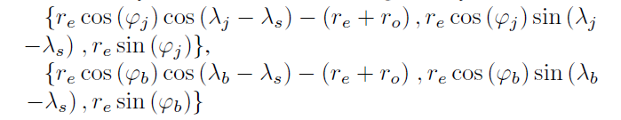

A Novel User Scheduling
Phase 1. Initial User Association:
Definition 1: Locations uj and vb on the surface of the Earth have corresponding satellite-centered coordinates {$X_{uj}^{}$, $Y_{uj}^{}$ ,$Z_{uj}^{}$}and {$X_{vb}^{}$ ,${ Y}_{vb}^{}$ , $Z_{vb}^{}$} in a satellite-centered coordinate system ,which are respectively calculated as
Notes:
User scheduling第一步就是要先知道每個user的關聯
所以他先去計算每個user以衛星為原點的的3軸位置，
ro = 35786 km (衛星在赤道上方高度)
Longitude of the satellite is λs = 19.2 degree

Slide 15


$u_{j}^{}$⨯ $v_{b}^{}$ is expressed as $\sqrt{Ϝ_{}^{2}+⊃_{}^{2}{+Π}_{}^{2}}$
$Ϝ$= $Y_{u_{j}}$ $Z_{v_{b}}$- $Z_{u_{j}}$ $Y_{v_{b}}$
$⊃$ = $Z_{u_{j}}$ $X_{v_{b}}$- $X_{u_{j}}$ $Z_{v_{b}}$
${Π= X}_{u_{j}} Y_{v_{b}}$- $Y_{u_{j}}$ $X_{v_{b}}$
$u_{j}^{}$˙${ v}_{b}^{}$ is denoted as $X_{u_{j}} X_{v_{b}}$+ $Y_{u_{j}}$ $Y_{v_{b}}+$ $Z_{u_{j}}$ $Z_{v_{b}}$
Notes:
然後用user座標與衛星座標做外積跟內積，就可以求出user跟satellite之間的離軸角，

Slide 16
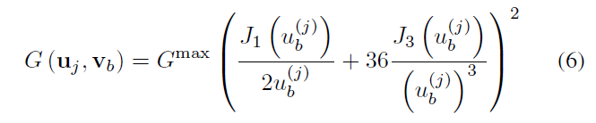

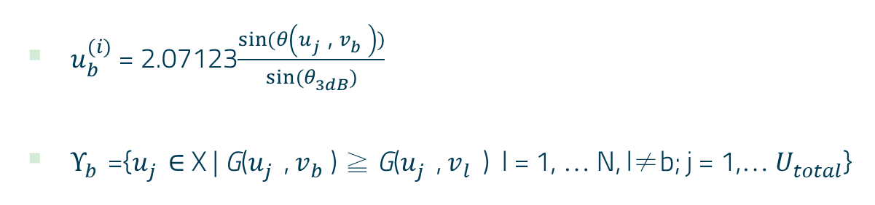
Recalling (3), beam gain G($u_{j}^{}$, $v_{b}^{}$) can be redefined as the function of variable $u_{j}^{}$ and $v_{b}^{}$ before beam association, i.e.,
$u_{b }^{(i)}$ = 2.07123$\frac{sin⁡(θ\left(u_{j}^{}\text{, }v_{b}^{}\right))}{sin⁡(θ_{3dB}^{})}$
${\text{Υ}}_{b}^{}$={$u_{j }^{}$∈ X | G($u_{j}^{}$, $v_{b}^{}$) ≧ G($u_{j}^{}$, $v_{l}^{}$) l = 1, … N, l≠b; j = 1,… $U_{total}^{}$}
Notes:
就可以把剛剛的離軸角帶入前面提到的公式，去計算beam gain。
然後去紀錄對於每個user最大的beam gain，就可以知道每個user是用哪個beam

Slide 17
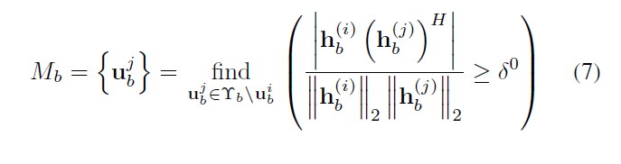

Phase 2. Searching NOMA User Candidates with High Channel Correlation:
After user association, we first select a primary user $u_{b}^{i}$with low date rate requirement from ${\text{Υ}}_{b}^{}$.
Next, we proceed to seeking users from ${\text{Υ}}_{b}^{}$ / $u_{b}^{i}$, whose channel correlations with the primary user are larger than a threshold ${\text{δ}}_{}^{0}$ ,
Notes:
第二步是要先從b的beam裡選擇一個primary user ，再來去尋找其他的user , 取決的條件就是看跟primary user的channel correlation 高的，只要高於一個給定的threshold 就把他列為候選者內

Slide 18
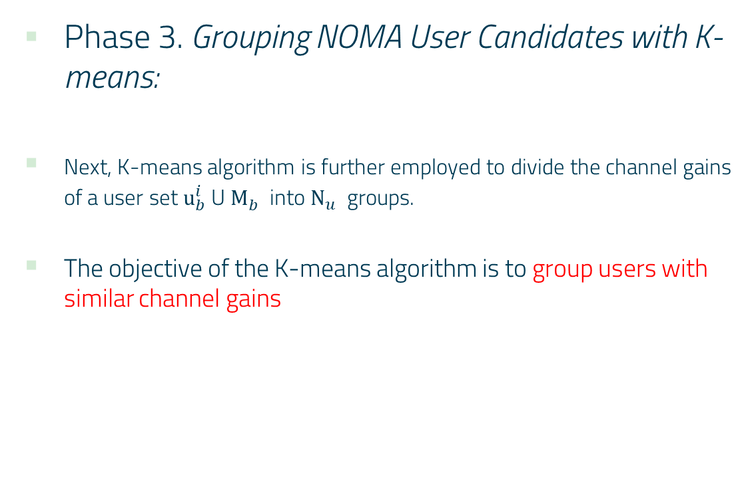
Phase 3. Grouping NOMA User Candidates with K-means:
Next, K-means algorithm is further employed to divide the channel gains of a user set ${\text{u}}_{b}^{i}$ U ${\text{M}}_{b}^{}$ into ${\text{N}}_{u}^{}$ groups.
The objective of the K-means algorithm is to group users with similar channel gains
Notes:
接著在第3部的時候將剛剛選到的候選者，在之中選出 $\text{N}$u 個group (大約是2~3個)，方法是用k-means，這樣一來，每個group中的user 的channel gain就會相似，

Slide 19
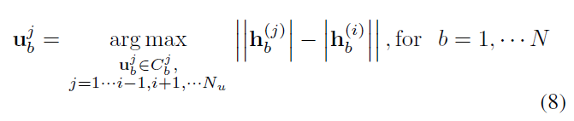
Phase 4. Scheduling NOMA Users with Maximum Channel Gain Difference:
Then, we successively schedule users that belong to different user groups, so as to maximize corresponding channel gain difference from the primary user per beam.
Notes:
最後去schedule 不同beam的primary user 讓它們的channel gain差異最大。

Slide 20
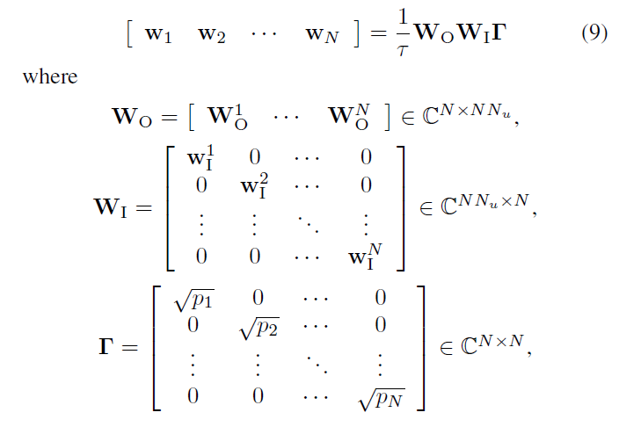
B. Multi-layer Beamforming
Notes:
這邊設計了3層的beamforming
第一步，我們考慮抑制beam之間與beam內干擾，
第二步，減少beam之間干擾後，通過優化每個用戶的channel，增加用戶有效channel的差異。
在第三步驟中，根據不同的功率分配來限定beam的功率。

Slide 21

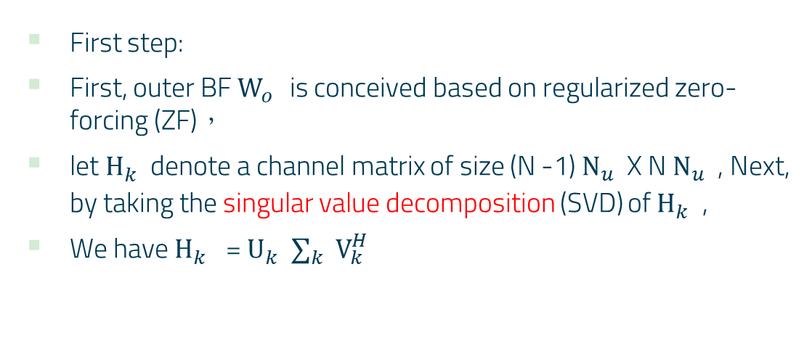
B. Multi-layer Beamforming
First step:
First, outer BF ${\text{W}}_{o}^{}$ is conceived based on regularized zero-forcing (ZF)，
let ${\text{H}}_{k}^{}$ denote a channel matrix of size (N -1) ${\text{N}}_{u}^{}$ X N ${\text{N}}_{u}^{}$ , Next, by taking the singular value decomposition (SVD) of ${\text{H}}_{k}^{}$ ,
We have ${\text{H}}_{k}^{}$ = ${\text{U}}_{k}^{}$ $∑_{k}^{}$ ${\text{V}}_{k}^{H}$
Notes:
第一步主要是使用zero-forcing減少干擾，並且使用奇異直分解
SVD 可以刪去影響力小的部分，換句話說 可以消除雜訊
${\text{U}}_{k}^{}$ isthe left singular matrix of size (N -1)Nu (N -1)Nu,
$∑_{k}^{}$ is the (N -1)Nu NNu diagonal matrix,
${\text{V}}_{k}^{H}$ is right singular matrix of size NNu NNu.

Slide 22
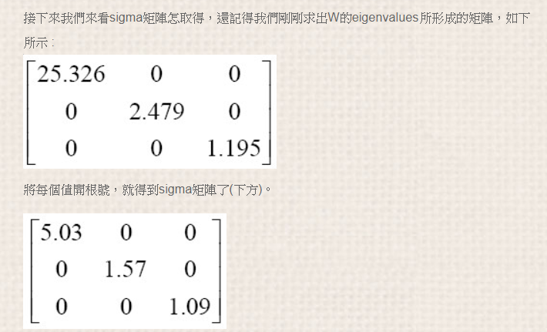
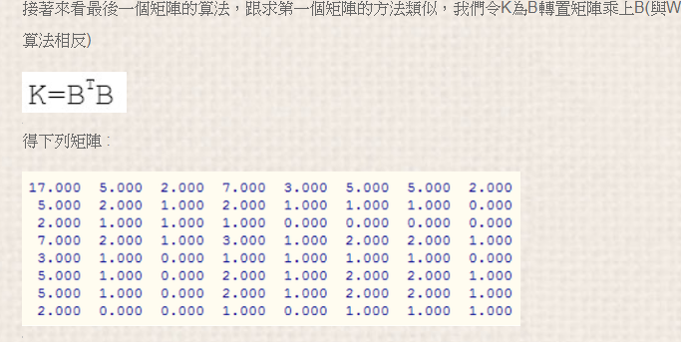
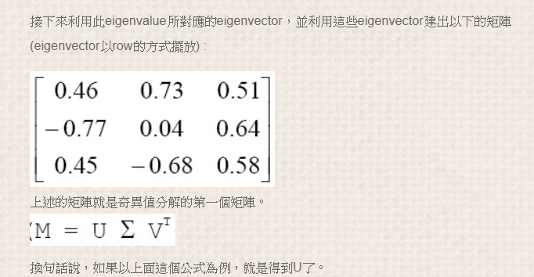
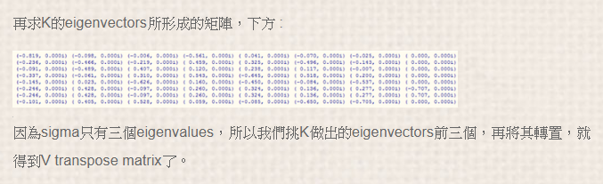
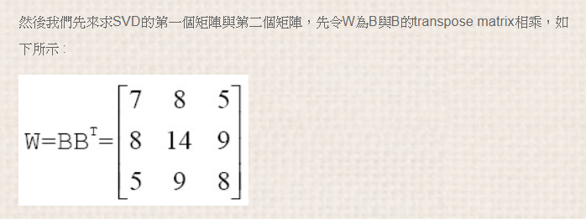
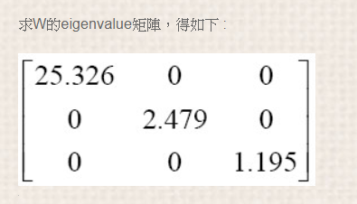
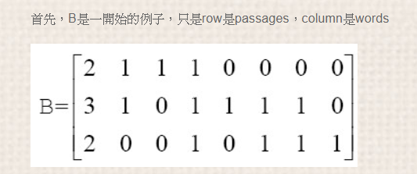

Slide 23
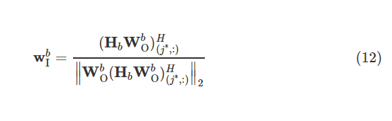

Second step:
We increase the difference of users’ effective channel gain by optimizing each user’s effective channel after inter-beam interference suppression.
Enhancing user ${\text{u}}_{b}^{j∗}$'s effective channel gain based on maximal ratio transmission, which is motivated by
Notes:
第二步，在抑制beam之間干擾後，通過以最大傳輸的速率去優化每個用戶的有效信道，增加用戶有效信道增益的差異

Slide 24


Third step:
In the third step, inter-beam power allocation is performed according to the desired performance metric.
Considering equal inter-beam power allocation, we get ${\text{p}}_{b}^{}$ =${\text{p}}_{total}^{}$ /N
Notes:
第三步，根據power 限制來執行beam間功率分配。

Slide 25
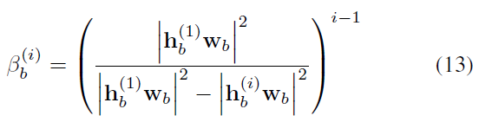


C. Dynamic Power Allocation Scheme with Target Data Rates
Dynamic Intra-beam Power Allocation:
For the sake of our exposition, an auxiliary variable $β_{b}^{(i)}$= $\frac{α_{b}^{(i)}}{α_{b}^{(i−1)}}$ is introduced to denote the power allocation relationship between user $u_{b}^{i}$and user $u_{b}^{i−1}$in beam b
Notes:
最後是他要動態分配power
一開始先排序user的channel gain， 因此後面的比前面來的小， 用貝塔表示當前user跟上一個user的power 分配關西，
那代表說，因為後面的通道狀況比較差，因此power必須打的比較多，但是這樣一來沒辦法保證primary user 能夠達到需要的data rate，
目標數據速率對功率分配策略施加了約束 ，就是每個用戶都有最小的data rate ，不可以小於它

Slide 26
SIMULATION RESULTS

Slide 27
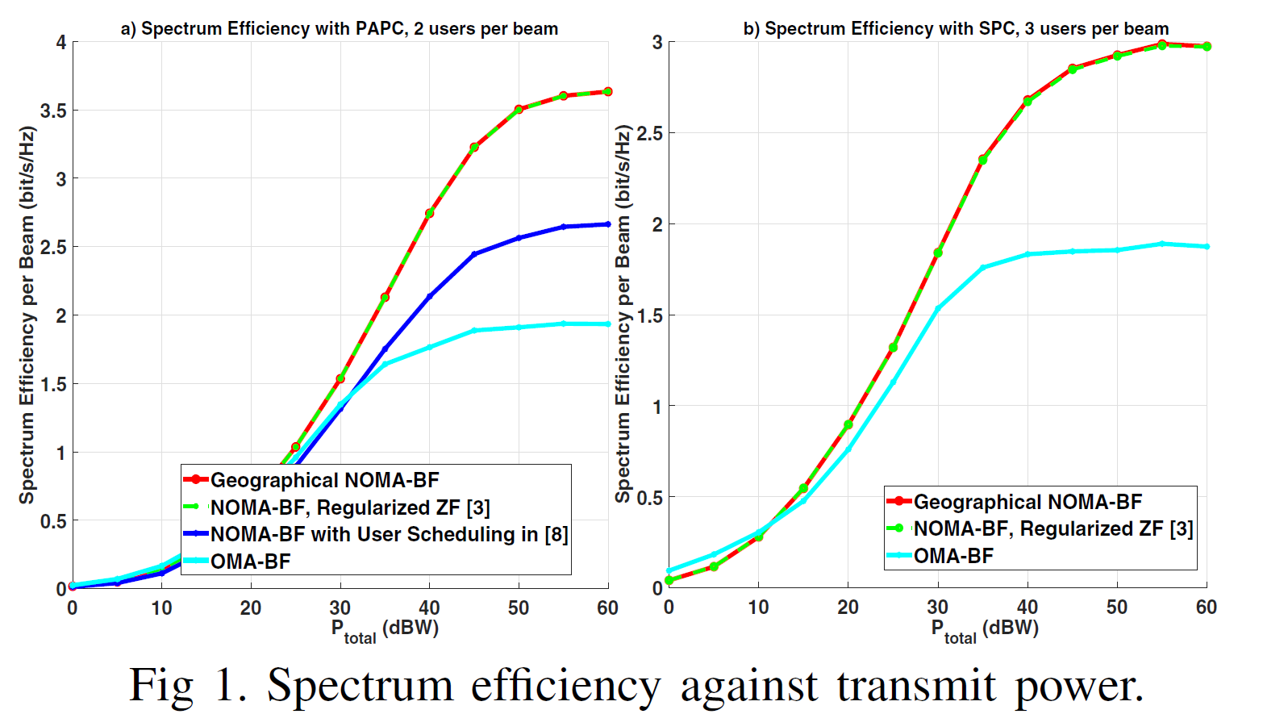
Notes:
最後實驗比較了4種方式
1.本paper提出的 geographic noma beamforming
2. NOMA-BF with user scheduling
3. OMA- BF
4. NOMA- BF reqularized ZF
可以看到使用geo noma 跟noma reqularized ZF 相比不管是 PAPC or SPC 他的頻譜效能差不多，但是作者提到基於geographic的user scheduling比較好

Slide 28
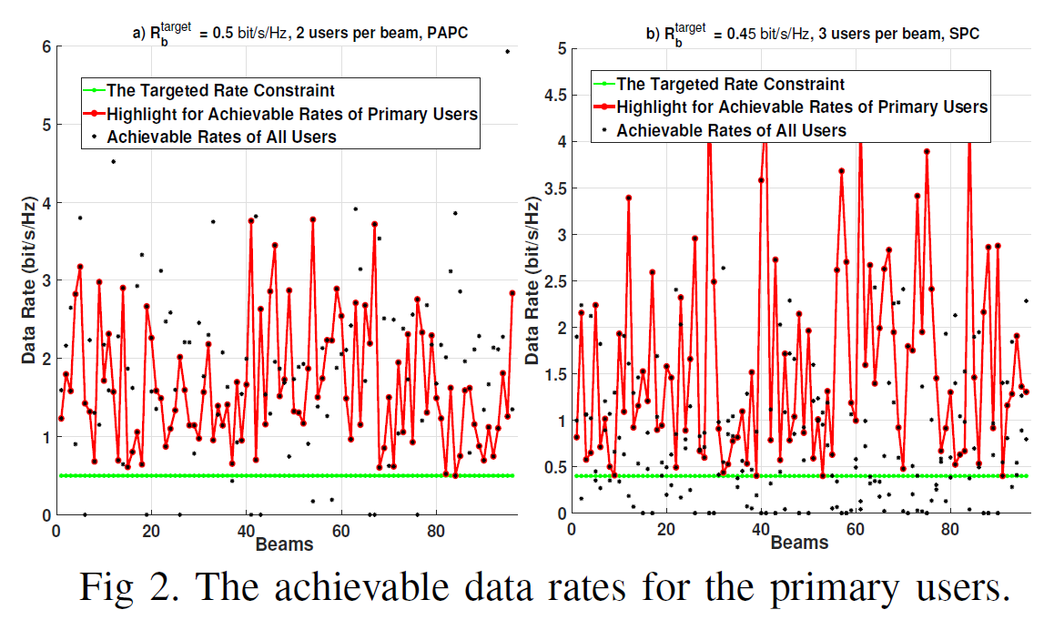
Notes:
實驗解果也表明不管是PAPC 還是SPC ，都能夠滿足primary user data rate的需求(綠色那條線)

Slide 29
Conclusion
In this work, a geographical NOMA-BF scheme is proposed to improve spectrum efficiency in multi-beam satellite-based IoT, where more than two users are simultaneously served in each beam. In addition, by employing the proposed user scheduling, multi-layer BF and power allocation policy, spectrum efficiency of multi-beam satellite-based IoT is improved while meeting predefined target data rates of primary NOMA users. Simulation results show the efficiency of our proposal.
Notes:
在這篇提出了地理的NOMA-BF方案以提高頻譜使用率，此外透過建議的user scheduling， multi-layer beamforming，以及power allocation ，在滿足primary user的 data rate的通時，提高了頻譜效率。

Slide 30
THANKS!

